Slide 1
QUERY PROCESSING & SECURITY

Slide 2
Overview of Query Processing
Query Processing is a translation of high-level queries into low-level expression.
It is a step wise process that can be used at the physical level of the file system, query optimization and actual execution of the query to get the result.
It requires the basic concepts of relational algebra and file structure.
It refers to the range of activities that are involved in extracting data from the database.
It includes translation of queries in high-level database languages into expressions
that can be implemented at the physical level of the file system.
In query processing, we will actually understand how these queries are processed
and how they are optimized.

Slide 3
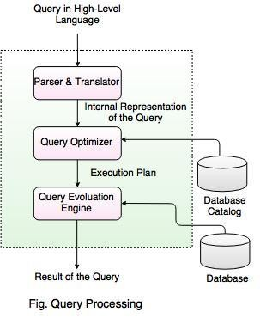
Overview of Query Processing
In the above diagram,
The first step is to transform the query into a standard form.
A query is translated into SQL and into a relational algebraic expression. During this process, Parser checks the syntax and verifies the relations and the attributes which are used in the query.
The second step is Query Optimizer. In this, it transforms the query into equivalent expressions that are more efficient to execute.
The third step is Query evaluation. It executes the above query execution plan and returns the result.

Slide 4
Measuring of Query Cost
Cost is generally measured as total elapsed time for answering query.
Many factors contribute to time cost - disk accesses, CPU, or even network communication.
Typically disk access is the predominant cost, and is also relatively easy to
estimate.
Measured by taking into account –
Number of seeks
Number of blocks read
Number of blocks written
Cost to write a block is greater than cost to read a block – data is read back after being written to ensure that the write was successful.

Slide 5
Measuring of Query Cost
For simplicity we just use number of block transfers from disk as the cost measure.
We ignore the difference in cost between sequential and random I/O for simplicity.
We also ignore CPU costs for simplicity. Costs depends on the size of the buffer in main memory. Having more memory reduces need for disk access.
Amount of real memory available to buffer depends on other concurrent OS processes, and hard to determine ahead of actual execution.
We often use worst case estimates, assuming only the minimum amount of
memory needed for the operation is available.
Real systems take CPU cost into account, differentiate between sequential and random I/O, and take buffer size into account. We do not include cost to writing output to disk in our cost formulae.

Slide 6
Selection Operation
File scan – search algorithms that locate and retrieve records that fulfill a
selection condition.
Algorithm A1 (linear search). Scan each file block and test all records to see whether they satisfy the selection condition.
Cost estimate (number of disk blocks scanned) = br
- br denotes number of blocks containing records from relation r
If selection is on a key attribute, cost = (br/ 2) (stop on finding record)
Linear search can be applied regardless of
∗ selection condition, or
∗ ordering of records in the file, or
∗ availability of indices

Slide 7
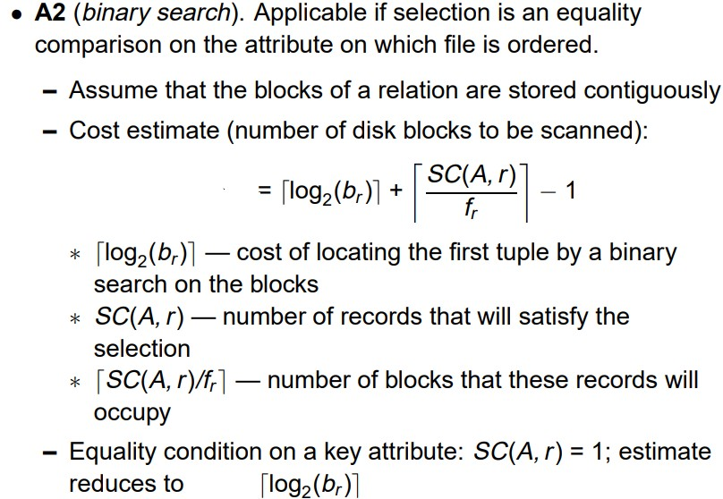
Selection Operation

Slide 8
Sorting Operation
We may build an index on the relation, and then use the index to read the relation in sorted order. May lead to one disk block access for each tuple.
For relations that fit in memory, techniques like quicksort can be used. For
relations that don’t fit in memory, external sort-merge is a good choice.

Slide 9
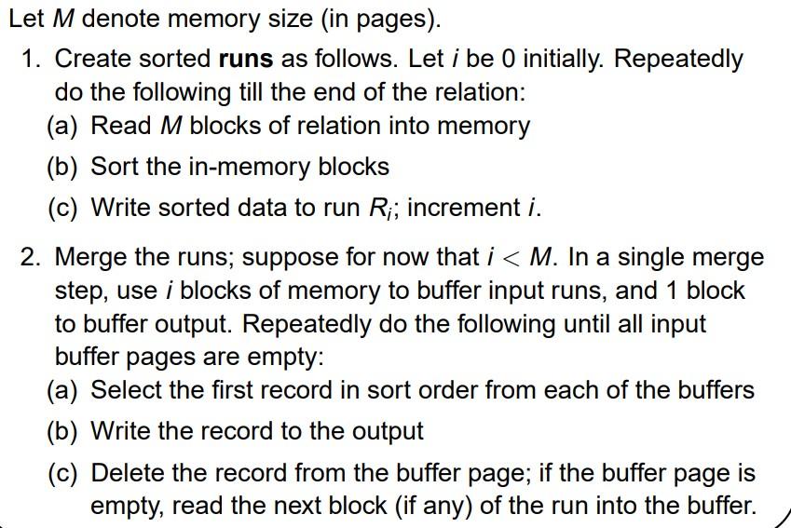
External Sort–Merge

Slide 10
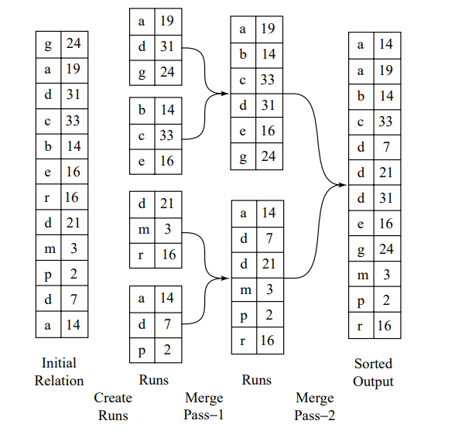
External Sort–Merge Example

Slide 11
Join Operation
Several different algorithms to implement joins
Nested-loop join
Block nested-loop join
Indexed nested-loop join
Merge-join
Hash-join
Choice based on cost estimate
Join size estimates required, particularly operations in a relational-algebra expression.
for cost estimates for outer-level

Slide 12
Evaluation of Expressions
The obvious way to evaluate an expression is simply to evaluate one operation at a time, in an appropriate order. The result of each evaluation is materialized in a temporary relation for subsequent use. A disadvantage to this approach is the need to construct the temporary relations, which (unless they are small) must be written to disk. An alternative approach is to evaluate several operations simultaneously in a pipeline, with the results of one operation passed on to the next, without the need to store a temporary relation.

Slide 13
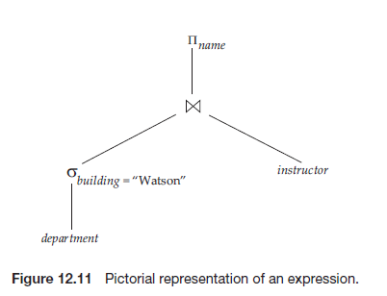
Evaluation of Expressions
Materialization:
Consider the expression;

Slide 14
Evaluation of Expressions
Materialization:
If we apply the materialization approach, we start from the lowest-level operations in the expression (at the bottom of the tree). In our example, there is only one such operation: the selection operation on department. The inputs to the lowest-level operations are relations in the database. We execute these operations by the algorithms that we studied earlier, like selection, join etc, and we store the results in temporary relations. We can use these temporary relations to execute the operations at the next level up in the tree, where the inputs now are either temporary relations or relations stored in the database. In our example, the inputs to the join are the instructor relation and the temporary relation created by the selection on department. The join can now be evaluated, creating another temporary relation.

Slide 15
Evaluation of Expressions
Materialization:
By repeating the process, we will eventually evaluate the operation at the root of the tree, giving the final result of the expression. In the earlier example, we get the final result by executing the projection operation at the root of the tree, using as input the temporary relation created by the join.
This is known as materialized evaluation, since the results of each intermediate operation are created (materialized) and then are used for evaluation of the next-level operations.
To compute the cost of evaluating an expression as done here, we have to add the costs of all the operations, as well as the cost of writing the intermediate results to disk.

Slide 16
Evaluation of Expressions
Pipelining:
We can improve query-evaluation efficiency by reducing the number of temporary files that are produced. We achieve this reduction by combining several relational operations into a pipeline of operations, in which the results of one operation are passed along to the next operation in the pipeline. This is called pipelined evaluation.
For example, consider the expression If materialization were applied, evaluation would involve creating a temporary relation to hold the result of the join, and then reading back in the result to perform the projection. These operations can be combined: When the join operation generates a tuple of its result, it passes that tuple immediately to the project operation for processing. By combining the join and the projection, we avoid creating the intermediate result, and instead create the final result directly.

Slide 17
Evaluation of Expressions
Pipelining:
Creating a pipeline of operations can provide two benefits:
It eliminates the cost of reading and writing temporary relations, reducing the cost of query evaluation.
It can start generating query results quickly, if the root operator of a query evaluation plan is combined in a pipeline with its inputs. This can be quite useful if the results are displayed to a user as they are generated, since otherwise there may be a long delay before the user sees any query results.

Slide 18
Query Optimization
A single query can be executed through different algorithms or re-written in different forms and structures.
Hence, the question of query optimization comes into the picture – Which of these forms or pathways is the most optimal? The query optimizer attempts to determine the most efficient way to execute a given query by considering the possible query plans.
A query optimizer is a critical database management system (DBMS) component that analyses Structured Query Language (SQL) queries and determines efficient execution mechanisms.
A query optimizer generates one or more query plans for each query, each of which may be a mechanism used to run a query. The most efficient query plan is selected and used to run the query.
Database users do not typically interact with a query optimizer, which works in the
background.

Slide 19
Query Optimization
Consider the following relational-algebra expression, for the query “Find the names of all instructors in the Music department together with the course title of all the courses that the instructors teach.”
Since we are concerned with only those tuples in the instructor relation that pertain to the Music department, we do not need to consider those tuples that do not have dept name = “Music”. By reducing the number of tuples of the instructor relation that we need to access, we reduce the size of the intermediate result. Our query is now represented by the relational-algebra expression:

Slide 20
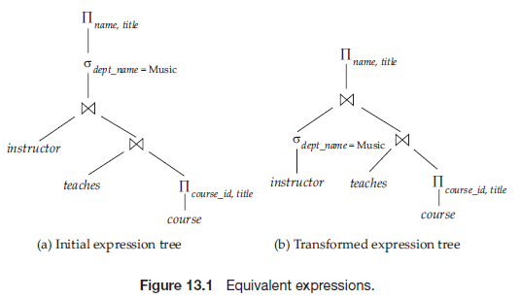
Query Optimization

Slide 21
Query Optimization
To find the least-costly query-evaluation plan, the optimizer needs to generate alternative plans that produce the same result as the given expression, and to choose the least-costly one. Generation of query-evaluation plans involves three steps:
generating expressions that are logically equivalent to the given expression,
annotating the resultant expressions in alternative ways to generate alternative query-evaluation plans, and
estimating the cost of each evaluation plan, and choosing the one whose estimated cost is the least

Slide 22
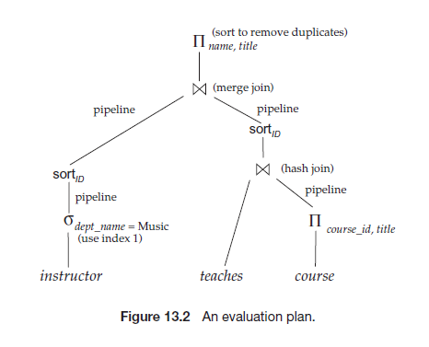
Query Optimization

Slide 23
Importance of Query Optimization
The goal of query optimization is to reduce the system resources required to fulfill a query, and ultimately provide the user with the correct result set faster.
First, it provides the user with faster results, which makes the application seem
faster to the user.
Secondly, it allows the system to service more queries in the same amount of
time, because each request takes less time than unoptimized queries.
Thirdly, query optimization ultimately reduces the amount of wear on the hardware (e.g. disk drives), and allows the server to run more efficiently (e.g. lower power consumption, less memory usage).

Slide 24
Query Optimization Process
There are broadly two ways a query can be optimized:
Analyze and transform equivalent relational expressions: Try to minimize the tuple and column counts of the intermediate and final query processes.
Using different algorithms for each operation: These underlying algorithms determine how tuples are accessed from the data structures they are stored in, indexing, hashing, data retrieval and hence influence the number of disk and block accesses.

Slide 25
Database Administrator (DBA)
A database administrator (DBA) is a specialized computer systems administrator who maintains a successful database environment by directing or performing all related activities to keep the data secure.
The top responsibility of a DBA professional is to maintain data integrity. This means the DBA will ensure that data is secure from unauthorized access but is available to users.
A database administrator will often have a working knowledge and experience with a wide range of database management products such as Oracle-based software, and SQL, in addition to having obtained a degree in Computer Science and practical field experience and additional, related IT certifications.

Slide 26
Types of DBA
There are different types of DBAs depending on the an organization's requirements:
Administrative DBA – maintains the servers and databases and keeps them running. Concerned with backups, security, patches, replication. These are activities mostly geared towards maintaining the database and software platform, but not really involved in enhancing or developing it.
Development DBA - works on building SQL queries, stored procedures, and so on, that meet business needs. This is the equivalent of a programmer, but specializing in database development. Commonly combined the role of Administrative DBA.
Data Architect – designs schemas, builds tables indexes, data structures and relationships. This role works to build a structure that meets a general business needs in a particular area.
Data Warehouse DBA - this is a relatively newer role, responsible for merging data from multiple sources into a data warehouse. May have to design the data warehouse as well as cleaning up and standardizing the data before loading using specialist data loading and transformation tools.

Slide 27
Roles & Responsibilities of DBA
Database installation, upgrade and patching
Install and configure relevant network components
Ensure database access, consistency and integrity
Resolving issues related to performance bottlenecks
Provide reporting on various metrics including availability, usage and performance
Performance testing and benchmark activities
Work with development staff on architectures, coding standards, and quality assurance policies
Create models for new database development or changes to existing ones
Respond to and resolve database access and performance issues
Monitor database system details
Design and implement redundant systems, policies, and procedures for disaster
recovery

Slide 28
Roles & Responsibilities of DBA
Monitor, optimize and allocate physical data storage for database systems
Plan and coordinate data migrations
Develop, implement, and maintain change control and testing processes
Perform database transaction and security audits
Establish end-user database access control levels
Implement database encryption and data encryption
Plan and ensure compliance with established best practices, related policies and legislation
Participate as a member of a team to move the team toward the completion of its
goals
Capacity planning, installation, configuration, database design, migration, performance monitoring, security, troubleshooting, as well as backup and data recovery.

Slide 29
Database Security
Database security refers to the collective measures used to protect and secure a database or database management software from illegitimate use and malicious threats and attacks.
Database security covers and enforces security on all aspects and components of
databases. This includes:
Data stored in database
Database server
Database management system (DBMS)
Other database workflow applications
Database security is generally planned, implemented and maintained by a database administrator and or other information security professional.

Slide 30
Threats to Database
Loss of integrity: Database integrity refers to the requirement that information be protected from improper modification. Modification of data includes creating, inserting, and updating data; changing the status of data; and deleting data. Integrity is lost if unauthorized changes are made to the data by either intentional or accidental acts. If the loss of system or data integrity is not corrected, continued use of the contaminated system or corrupted data could result in inaccuracy, fraud, or erroneous decisions.
Loss of availability: Database availability refers to making objects available to a human user or a program who/which has a legitimate right to those data objects. Loss of availability occurs when the user or program cannot access these objects.
Loss of confidentiality: Database confidentiality refers to the protection of data from unauthorized disclosure. The impact of unauthorized disclosure of confidential information can range from violation of the Data Privacy Act to the jeopardization of national security. Unauthorized, unanticipated, or unintentional disclosure could result in loss of public confidence, embarrassment, or legal action against the organization.

Slide 31
Database Security Issues
No Security Testing Before Deployment
Poor Encryption and Data Breaches Come Together
Stolen Database Backups
Flaws in Features
Weak and Complex DB Infrastructure
Limitless Administration Access = Poor Data Protection
Inadequate Key Management
Irregularities in Databases

Slide 32
Types of Database Security
The database security can be broadly classified into physical and logic security.
Physical security - security of hardware associated with the system and the protection of the site where the computer resides.
Logical security - security measures residing in the operating system or the
DBMS designed to handle threats to data.
Following measures can be used to secure database:
Access authorization.
Access controls.
Backup and recovery of data.
Data integrity.
Encryption of data.

Slide 33
Database Security
It is now customary to refer to two types of database security mechanisms:
Discretionary security mechanisms: These are used to grant privileges to users, including the capability to access specific data files, records, or fields in a specified mode (such as read, insert, delete, or update).
Mandatory security mechanisms: These are used to enforce multilevel security by classifying the data and users into various security classes (or levels) and then implementing the appropriate security policy of the organization.

Slide 34
Control Measures
Four main control measures are used to provide security of data in databases:
Access control
Inference control
Flow control
Data encryption
Above control measures define the level of access protections.

Slide 35
Control Measures
Access Control is a way of preventing unauthorized persons from accessing the system itself, either to obtain information or to make malicious changes in a portion of the database. The security mechanism of a DBMS must include provisions for restricting access to the database system as a whole.
Statistical databases are used to provide statistical information or summaries of values based on various criteria. Security for statistical databases must ensure that information about individuals cannot be accessed. It is sometimes possible to deduce or infer certain facts concerning individuals from queries that involve only summary statistics on groups; consequently, this must not be permitted either. The control measure used to prevent is known as inference control.
Another security issue is that of flow control, which prevents information from flowing in such a way that it reaches unauthorized users.

Slide 36
Control Measures
A final control measure is data encryption, which is used to protect sensitive data (such as credit card numbers) that is transmitted via some type of communications network. Encryption can be used to provide additional protection for sensitive portions of a database as well. The data is encoded using some coding algorithm, known as encryption algorithm. An unauthorized user who accesses encoded data will have difficulty decoding/deciphering it, but authorized users are given decoding or decrypting algorithms to decipher the data. Both of the encoding and decoding algorithms use some parameters like key for encrypting and decrypting data.

Slide 37
Access Protection/Control
Access control is a security technique that regulates who or what can view or use resources in a computing environment. It is a fundamental concept in security that minimizes risk to the business or organization.
There are two types of access control: physical and logical.
Physical access control limits access to campuses, buildings, rooms and physical IT
assets.
Logical access control limits connections to computer networks, system files and data.
To secure a facility, organizations use electronic access control systems that rely on user credentials, access card readers, auditing and reports to track employee access to restricted business locations and proprietary areas, such as data centres.
Access control systems perform identification authentication and authorization of users and entities by evaluating required login credentials that can include passwords, personal identification numbers (PINs), biometric scans, security tokens or other authentication factors. Multifactor authentication, which requires two or more authentication factors, is often an important part of layered defence to protect access control systems.

Slide 38
User Account and Database Audits
Database auditing involves observing a database so as to be aware of the actions of database users.
Database administrators and consultants often set up auditing for security purposes, for example, to ensure that those without the permission to access information do not access it.
Audit is an analysis of an organization's Computer and information systems in order to evaluate the efficiency, correctness & integrity of its database systems as well as to uncover potential Security Cracks.
Auditing is done to verify that DBMS operations are properly implemented and executed.

Slide 39
User Accounts and Database Audits
Whenever a person or a group of persons needs to access a database system, the individual or group must first apply for a user account. The DBA will then create a new account number and password for the user if there is a legitimate need to access the database. The user must log in to the DBMS by entering the account number and password whenever database access is needed. The DBMS checks that the account number and password are valid; if they are, the user is permitted to use the DBMS and to access the database.
It is straightforward to keep track of database users and their accounts and passwords by creating an encrypted table or file with two fields: Account Number and Password. This table can easily be maintained by the DBMS. Whenever a new account is created, a new record is inserted into the table. When an account is canceled, the corresponding record must be deleted from the table.

Slide 40
User Accounts and Database Audits
The database system must also keep track of all operations on the database that are applied by a certain user throughout each login session, which consists of the sequence of database interactions that a user performs from the time of logging in to the time of logging off.
To keep a record of all updates applied to the database and of particular users who applied each update, the system log is maintained. The system log includes an entry for each operation applied to the database that may be required for recovery from a transaction failure or system crash.
If any tampering with the database is suspected, a database audit is performed, which consists of reviewing the log to examine all accesses and operations applied to the database during a certain time period.

Slide 41
User Accounts and Database Audits
When an illegal or unauthorized operation is found, the DBA can determine the account number used to perform the operation. Database audits are particularly important for sensitive databases that are updated by many transactions and users, such as a banking database that can be updated by thousands of bank tellers. A database log that is used mainly for security purposes serves as an audit trail.

Slide 42
Discretionary access control (DAC)
Discretionary access control (DAC) is a type of security access control that grants or restricts object access via an access policy determined by an object's owner group and/or subjects.
DAC mechanism controls are defined by user identification with supplied
credentials during authentication, such as username and password.
DACs are discretionary because the subject (owner) can transfer authenticated objects or information access to other users. In other words, the owner determines object access privileges.
Advantages
ACL maintenance or capability
Grant and revoke permissions maintenance

Slide 43
Discretionary Access Control
Discretionary access control is based on the concept of access rights (also called privileges) and mechanism for giving users such privileges. It grants the privileges (access rights) to users on different objects, including the capability to access specific data files, records or fields in a specified mode, such as, read, insert, delete or update or combination of these. A user who creates a database object such as a table or a view automatically gets all applicable privilege on that object. The DBMS keeps track of how these privileges are granted to other users.
The typical method of enforcing discretionary access control in a database system is based on the granting and revoking privileges.

Slide 44
Discretionary Access Control
Discretionary Access Control (DAC) enforces security by means of user identifiers(uid) and group identifiers (gid); only the owner of the data (i.e., the Content Provider) holds the r/w permissions on the file.
Each data object on a DAC based system has an Access Control List (ACL) associated with it. An ACL contains a list of users and groups to which the user has permitted access together with the level of access for each user or group. For example, User A may provide read-only access on one of her files to User B, read and write access on the same file to User C and full control to any user belonging to Group 1.

Slide 45
Discretionary Access Control
The account level:
At this level, the DBA specifies the particular privileges that each account holds independently of the relations in the database.
The relation level (or table level):
At this level, the DBA can control the privilege to access each individual relation or view in the database.

Slide 46
Discretionary Access Control
The privileges at the account level apply to the capabilities provided to the account itself and can include
the CREATE SCHEMA or CREATE TABLE privilege, to create a schema or base relation;
the CREATE VIEW privilege;
the ALTER privilege, to apply schema changes such adding or removing attributes from relations;
the DROP privilege, to delete relations or views;
the MODIFY privilege, to insert, delete, or update tuples;
and the SELECT privilege, to retrieve information from the database by using a SELECT query.

Slide 47
Discretionary Access Control
The privileges at the relation level apply base relations and views.
Each relation R in a database is assigned and owner account, This is typically the account that was used when the relation was created in the first place.
The owner of a relation is given all privileges on that relation.
The owner account holder can pass privileges on any of the owned relation to other users by granting privileges to their accounts.

Slide 48
Discretionary Access Control
In Relation Level, following types of privileges can be granted on each individual relation R:
SELECT (retrieval or read) privilege on R: Gives the account retrieval privilege. In SQL, this gives the account the privilege to use the SELECT statement to retrieve tuples from R.
Modification privileges on R: This gives the account the capability to modify the tuples of R. In SQL, this includes three privileges: UPDATE, DELETE, and INSERT.
References privilege on R: This gives the account the capability to reference (or refer to) a relation R when specifying integrity constraints. This privilege can also be restricted to specific attributes of R.

Slide 49
Discretionary Access Control
Granting of Privileges:
Whenever the owner A of a relation R grants a privilege on R to another account B, the privilege can be given to B with or without the GRANT OPTION. If the GRANT OPTION is given, this means that B can also grant that privilege on R to other accounts otherwise not.

Slide 50
Discretionary Access Control
Revoking of Privileges:
In some cases, it is desirable to grant a privilege to a user temporarily. For example, the owner of a relation may want to grant the SELECT privilege to a user for a specific task and then revoke that privilege once the task is completed. Hence, a mechanism for revoking privileges is needed. In SQL, a REVOKE command is included for the purpose of canceling privileges.

Slide 51
Discretionary Access Control
Examples of Granting and Revoking
GRANT INSERT, DELETE ON EMPLOYEE, DEPARTMENT TO A2;
GRANT SELECT ON EMPLOYEE, DEPARTMENT TO A3 WITH GRANT OPTION; (A3 can propagate grants to others)
GRANT SELECT ON EMPLOYEE TO A4; (A4 can’t propagate grant to others)
REVOKE SELECT ON EMPLOYEE FROM A3;

Slide 52
Mandatory access control (MAC)
Mandatory Access Control (MAC) is a set of security policies constrained according to system classification, configuration and authentication.
MAC policy management and settings are established in one secure network and limited to system administrators.
MAC defines and ensures a centralized enforcement of confidential security policy
parameters.
Advantages
MAC provides tighter security because only a system administrator may access or
alter controls.
MAC policies reduce security errors.

Slide 53
Mandatory Access Control
Mandatory Access Control (MAC) is based on clearance, i.e., security labels (secret, top secret, confidential, etc.). Data objects are given a security classification, and the user will be denied access if his clearance is lower than the classification of the object.
Similarly, each user account on the system also has classification and category properties from the same set of properties applied to the data objects. When a user attempts to access a data under Mandatory Access Control the system checks the user's classification and categories and compares them to the properties of the object's security label. If the user's credentials match the MAC security label properties of the data object access is allowed. It is important to note that both the classification and categories must match. A user with top secret classification, for example, cannot access a resource if they are not also a member of one of the required categories for that object.

Slide 54
Mandatory Access Control
Typical security classes
Top secret (TS),
Secret (S),
Confidential (C),
Unclassified (U),
Here TS is the highest level and U the lowest:
TS > S > C > U

Slide 55
Mandatory Access Control
Subjects
E.g., user, account, program
Objects
E.g., Relation, tuple, column, view, operation.
Subjects and Objects classified into, T, S, C, or U:
Clearance (classification) of a subject S denoted as class(S) and to the classification of an object O as class(O).

Slide 56
Mandatory Access Control
Two restrictions are enforced on data access based on the subject/object classifications:
Simple security property: A subject S is not allowed read access to an object O unless class(S) ≥ class(O).
Star property: A subject S is not allowed to write an object O unless class(S) ≤ class(O).

Slide 57
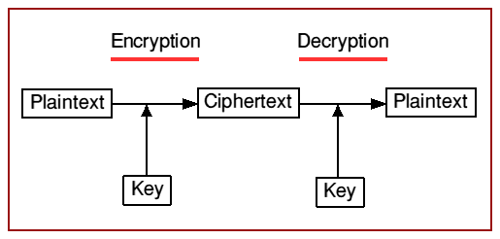
Data Encryption and Decryption
Database encryption is the process of converting data, within a database, in plain text format into a meaningless cipher text by means of a suitable algorithm.
Database decryption is converting the meaningless cipher text into the original
information using keys generated by the encryption algorithms.
Numerous algorithms are used for encryption. These algorithms generate keys related to the encrypted data.
These keys set a link between the encryption and decryption procedures. The encrypted data can be decrypted only by using these keys.

Slide 58
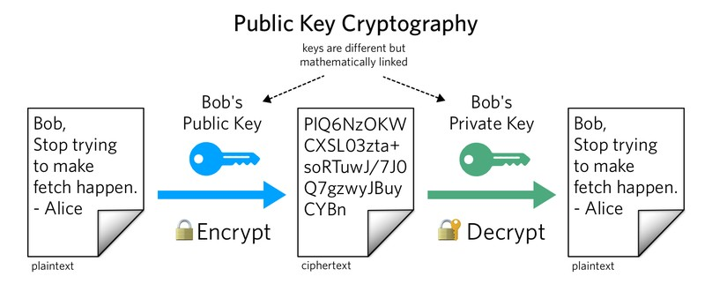
Public Key Cryptography
Public key cryptography (PKC) is an encryption technique that uses a paired public and private key (or asymmetric key) algorithm for secure data communication.
A message sender uses a recipient's public key to encrypt a message.
To decrypt the sender's message, only the recipient's private key may be used.

Slide 59
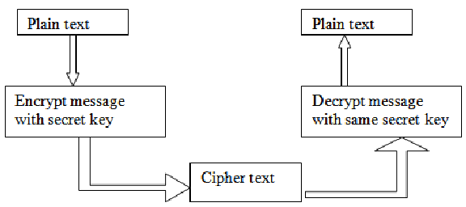
Secret Key Cryptography
Here only one key is used for both encryption and decryption. This type of encryption is also referred to as symmetric encryption.

Slide 60
Data Encryption and Decryption
Private (Symmetric) Key Algorithms
A symmetric key is one key that is used for both encryption and decryption.
By using a symmetric key, fast encryption and decryption is possible for routine use with sensitive data in the database.
A message encrypted with a secret key can be decrypted only with the same secret key.
Algorithms used for symmetric key encryption are called secret key algorithms. Since secret-key algorithms are mostly used for encrypting the content of a message, they are also called content-encryption algorithms.

Slide 61
Data Encryption and Decryption
Private (Symmetric) Key Algorithms
The major liability associated with secret-key algorithms is the need for sharing the secret key. A possible method is to derive the secret key from a user-supplied password string by applying the same function to the string at both the sender and receiver; this is known as a password-based encryption algorithm.
The strength of the symmetric key encryption depends on the size of the key used. For the same algorithm, encrypting using a longer key is tougher to break than the one using a shorter key.
Eg: DES, AES etc.

Slide 62
Data Encryption and Decryption
Public (Assymmetric) Key Algorithms
These algorithms use two related different keys, a public key and a private key, to perform encryption and decryption.
The use of two keys can have profound consequences in the areas of confidentiality, key distribution, and authentication.
The two keys used for public key encryption are referred to as the public key and the private key. The private key is kept secret, but it is referred to as a private key rather than a secret key (the key used in conventional encryption) to avoid confusion with conventional encryption. The two keys are mathematically related, since one of the keys is used to perform encryption and the other to perform decryption. However, it is very difficult to derive the private key from the public key.

Slide 63
Data Encryption and Decryption
Public (Assymmetric) Key Algorithms
As the name suggests, the public key of the pair is made public for others to use, whereas the private key is known only to its owner.
Eg: RSA, ElGamal etc.

Slide 64
Data Encryption and Decryption
Public (Assymmetric) Key Algorithms
A public key encryption scheme, or infrastructure, has followint ingredients:
Plaintext: This is the data or readable message that is fed into the algorithm as input.
Encryption algorithm: This algorithm performs various transformations on the plaintext.
Public and private keys: These are a pair of keys that have been selected so that if one is used for encryption, the other is used for decryption. The exact transformations performed by the encryption algorithm depend on the public or private key that is provided as input. For example, if a message is encrypted using the public key, it can only be decrypted using the private key.
Ciphertext: This is the scrambled message produced as output. It depends on the plaintext and the key. For a given message, two different keys will produce two different ciphertexts.
Decryption algorithm: This algorithm accepts the ciphertext and the matching key and produces the original plaintext

